Slide 1









My Number
Interactive Notebook
$$×$$
$$\frac{1}{2}$$
$$÷$$
$$+$$
$$−$$
$$\frac{3}{5}$$
$$7$$
Name
Class
Teacher
Term 1 Semester 1
$$5^{2}$$
$$\sqrt{9}$$
1

Slide 2
Contents
Glossary or Formula Page
Page
Date
Description
2
3

Slide 3
Tasks
24
7
30
Essential Question
Questions
Notes
Summary
6
7

Slide 4
Answer the following

Slide 5
24
7
30
Date
Order of operation
EQ – How do I solve a problem with more than one operation?
7

Slide 6
24
7
30
Date
Order of operation
EQ – How do I solve a problem with more than one operation?
In which order do I perform the mathematical operations?
7

Slide 7
24
7
30
Date
Order of operation
EQ – How do I solve a problem with more than one operation?
In which order do I perform the mathematical operations?
Brackets – Do any operations in brackets first.
7

Slide 8
24
7
30
Date
Order of operation
EQ – How do I solve a problem with more than one operation?
In which order do I perform the mathematical operations?
Brackets – Do any operations in brackets first.
Indices – Do next
7

Slide 9
24
7
30
Date
Order of operation
EQ – How do I solve a problem with more than one operation?
In which order do I perform the mathematical operations?
Brackets – Do any operations in brackets first.
Indices – Do next
Multiplication and Division – Do next in order from left to right
7

Slide 10
24
7
30
Date
Order of operation
EQ – How do I solve a problem with more than one operation?
In which order do I perform the mathematical operations?
Brackets – Do any operations in brackets first.
Indices – Do next
Multiplication and Division – Do next in order from left to right
Addition and Subtraction – Do next in order from left to right
7

Slide 11
24
7
30
Date
Order of operation
EQ – How do I solve a problem with more than one operation?
In which order do I perform the mathematical operations?
Brackets – Do any operations in brackets first.
Indices – Do next
Multiplication and Division – Do next in order from left to right
Addition and Subtraction – Do next in order from left to right
B I MD AS
e.g
7

Slide 12
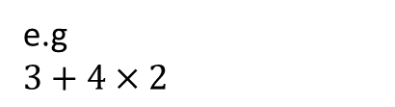
24
7
30
Date
Order of operation
EQ – How do I solve a problem with more than one operation?
In which order do I perform the mathematical operations?
Brackets – Do any operations in brackets first.
Indices – Do next
Multiplication and Division – Do next in order from left to right
Addition and Subtraction – Do next in order from left to right
B I MD AS
e.g
$3+4×2$
7

Slide 13
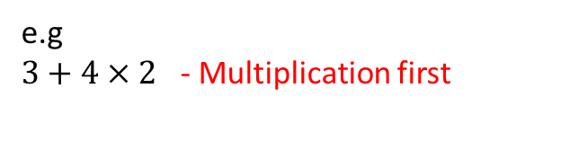
24
7
30
Date
Order of operation
EQ – How do I solve a problem with more than one operation?
In which order do I perform the mathematical operations?
Brackets – Do any operations in brackets first.
Indices – Do next
Multiplication and Division – Do next in order from left to right
Addition and Subtraction – Do next in order from left to right
B I MD AS
e.g
$3+4×2$ - Multiplication first
7

Slide 14
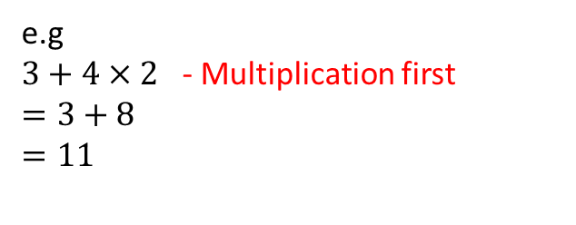
24
7
30
Date
Order of operation
EQ – How do I solve a problem with more than one operation?
In which order do I perform the mathematical operations?
Brackets – Do any operations in brackets first.
Indices – Do next
Multiplication and Division – Do next in order from left to right
Addition and Subtraction – Do next in order from left to right
B I MD AS
e.g
$3+4×2$ - Multiplication first
$$=3+8$$
$$=11$$
7

Slide 15
Do Exercise 7.1 and 7.2 – pages 88 & 89
Questions 1 to 12 in each exercise can be done by just writing the answer, from question 13 on you must write them out in full.

Slide 16
Notes Review
24, 7 ,30
Date
Title
Essential question
Notes complete
Notes complete with colour and diagrams
Questions completed
Contents page filed in
Formula page filled in

Slide 17
Homework
Review your notes and write a summary answering the essential question.

